Slide 1
Depression Project Progress
Name: Chen Yanru
University: Nanyang Technological University
Capstone Project Period: Jan-Dec 2024
MS in Data Science
Duration of the presentation:~13 minutes

Slide 2
Audio Part
DAIC-WOZ dataset
-189 folders of sessions 300 - 492 (Excluded sessions: 342,394,398,460)
-train_split_Depression_AVEC2017.csv
-dev_split_Depression_AVEC2017.csv
-test_split_Depression_AVEC2017.csv

Slide 3
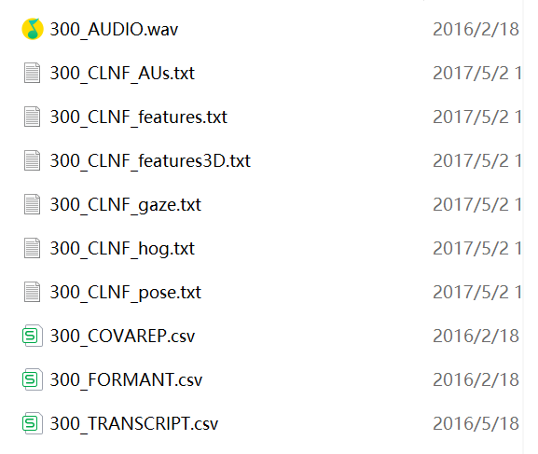
300_P\
Audio file
Audio features extracted using the COVAREP.¹

Slide 4
train_split_Depression_AVEC2017.csv
Participant_ID | PHQ8_Binary | PHQ8_Score | Gender | PHQ8_NoInterest | PHQ8_Depressed
303 | 0 | 0 | 0 | 0 | 0
304 | 0 | 6 | 0 | 0 | 1
305 | 0 | 7 | 1 | 0 | 1
310 | 0 | 4 | 1 | 1 | 1
312 | 0 | 2 | 1 | 0 | 0
PHQ8_Sleep | PHQ8_Tired | PHQ8_Appetite | PHQ8_Failure | PHQ8_Concentrating | PHQ8_Moving
0 | 0 | 0 | 0 | 0 | 0
1 | 2 | 2 | 0 | 0 | 0
1 | 2 | 2 | 1 | 0 | 0
0 | 0 | 0 | 1 | 1 | 0
1 | 1 | 0 | 0 | 0 | 0

Slide 5
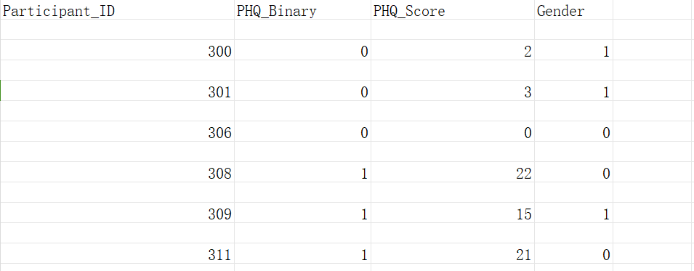
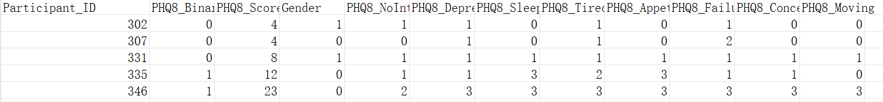
test_split_Depression_AVEC2017.csv
dev_split_Depression_AVEC2017.csv

Slide 6
Preprocess
Stages | Input | Output
Load data | CSV files for training validation and test | Arrays of data points (ID and class)
Obtaining Corresponding Audio Data | Corresponding _COVAREP file | Arrays of data points (ID and class)
Upsampling towards training set | Arrays of training data | Balanced arrays

Slide 7
Models
CNN
BiLSTM
CNN+BiLSTM

Slide 8
Model -CNN
Sturcture
Input layer
CNN Layers
Flattening
Full connection
(40000,74)
3 Convolutional layers:
use 60, 30, and 15 filters respectively, with kernel sizes of 10, 5, and 5.
pooling layer: pool size = 3
activation: relu, sigmoid

Slide 9
Model -BiLSTM
Sturcture
Input layer
BiLSTM Layers
Flattening
Full connection
Optimizer: adam
(40000,74)
3 BiLSTM layers:
use 60, 30, and 15 units respectively
activation: relu, sigmoid

Slide 10
Model -CNN+BiLSTM
Sturcture
Input layer
CNN Layers
BiLSTM
Flattening
Full connection
activation: relu, sigmoid
(40000,74)
3 Convolutional layers:
use 60, 30, and 15 filters respectively, with kernel sizes of 10, 5, and 5.
pooling layer: pool size = 3
BiLSTM layer:
use 64 units
Optimizer: adam

Slide 11
Results
Models | Accuracy | Recall | Precision | F1-score
CNN | 0.68 | 0.13 | 0.21 | 0.16
BiLSTM | 0.47 | 0.43 | 0.26 | 0.32
CNN+BiLSTM | 0.72 | 0.33 | 0.24 | 0.28

Slide 12
Compared to Yuxin’s work
Models | Accuracy | Recall | Precision | F1-score
CNN | 0.68/0.68 | 0.13/0.48 | 0.21/0.77 | 0.16/0.59
BiLSTM | 0.47/0.65 | 0.43/0.42 | 0.26/0.50 | 0.32/0.61
CNN+BiLSTM | 0.72/0.72 | 0.33/0.52 | 0.24/0.75 | 0.28/0.61

Slide 13
Plan for next week
Check reasons for the precision and recall score
Check CNN

Slide 14
Depression Project Progress
Date: Feb 21
Name: Chen Yanru
University: Nanyang Technological University
Capstone Project Period: Jan-Dec 2024
MS in Data Science
Duration of the presentation:~8 minutes

Slide 15
Question left from last week
Input layer: (40000,74)
(40000) is the number of time steps in the audio sequence
(74) represents the extracted features at each time step.
F0: Fundamental frequency (1 column)
VUV: Voiced/Unvoiced flag (1 column)
NAQ: Normalized Amplitude Quotient (1 column)
QOQ: Quasi-Open Quotient (1 column)
H1H2: Difference in amplitude between the first two harmonics (1 column)
PSP: Parabolic Spectral Parameter (1 column)
MDQ: Maxima Dispersion Quotient (1 column)
PeakSlope: Spectral slope at the peak (1 column)
Rd: Two-mass model parameter (1 column)
Rd_conf: Confidence measure for Rd (1 column)
MCEP_0-24: 25 Mel-Cepstral coefficients (25 columns)
HMPDM_0-24: 25 Harmonic Model and Phase Distortion Mean coefficients (25 columns)
HMPDD_0-12: 13 Harmonic Model and Phase Distortion Deviation coefficients (13 columns)
1+1+1+1+1+1+1+1+1+1+25+25+13 = 74

Slide 16
Change of environment
Models | Accuracy | Recall | Precision | F1-score
CNN | 0.55/0.68/0.68 | 0.13/0.36/0.48 | 0.21/0.29/0.77 | 0.32/0.16/0.59
BiLSTM | 0.45/0.47/0.65 | 0.34/0.43/0.42 | 0.25/0.26/0.50 | 0.29/0.32/0.61
CNN+BiLSTM | 0.60/0.72/0.72 | 0.07/0.33/0.52 | 0.14/0.24/0.75 | 0.10/0.28/0.61
2080Ti
Yuxin’s result
Google colab T4 GPU

Slide 17
Change of environment
Models | Accuracy | Recall | Precision | F1-score
CNN | 0.70/0.68/0.68 | 0.17/0.36/0.48 | 0.22/0.29/0.77 | 0.19/0.16/0.59
BiLSTM | 0.68/0.47/0.65 | 0.36/0.43/0.42 | 0.45/0.26/0.50 | 0.40/0.32/0.61
CNN+BiLSTM | 0.74/0.72/0.72 | 0.21/0.33/0.52 | 0.75/0.24/0.75 | 0.33/0.28/0.61
Google Colab V100
Yuxin’s result
Google colab T4 GPU

Slide 18
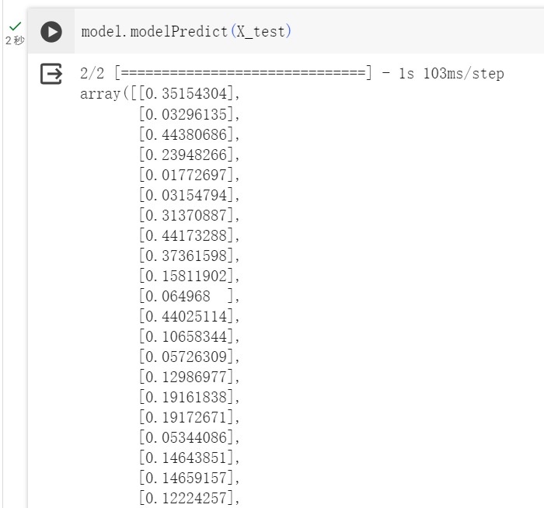
Thresholding: 0.8
train: 107
test: 47
validation: 35

Slide 19
Plan for next week
Try to use NSCC to repeat the experiment
Discussed with Xiangyu and Yuxin about audio feature extraction
MFCC or COVARAP - Check related work

Slide 20
Depression Project Progress
Date: Feb 28
Name: Chen Yanru
University: Nanyang Technological University
Capstone Project Period: Jan-Dec 2024
MS in Data Science
Duration of the presentation:~14 minutes

Slide 21
Question left from last week
Input layer: (40000,74)
(40000) is the number of time steps in the audio sequence
40000 is set by Yuxin, to ensure that all processed data can have the same shape for input into the model, since the lengths vary.

Slide 22
Guohou S, Lina Z, Dongsong Z. What reveals about depression level? The role of multimodal features at the level of interview questions[J]. Information & Management, 2020, 57(7): 103349.
Two points:
Feature selection
Question-level multimodel features

Slide 23
Guohou S, Lina Z, Dongsong Z. What reveals about depression level? The role of multimodal features at the level of interview questions[J]. Information & Management, 2020, 57(7): 103349.
Interpersonal interview: to build rapport with an interviewee and make him/her feel comfortable;
Wizard-of-Oz interview: questions about symptoms and events related to depression and Post-Traumatic Stress Disorder (PTSD), if any.
Automated interview: a ”cool-down” phase, intended to ensure that respondents would not leave the interview in a distressed state of mind
Interpersonal interviews
Wizard-of-Oz interviews
Automated interviews
[2]

Slide 24
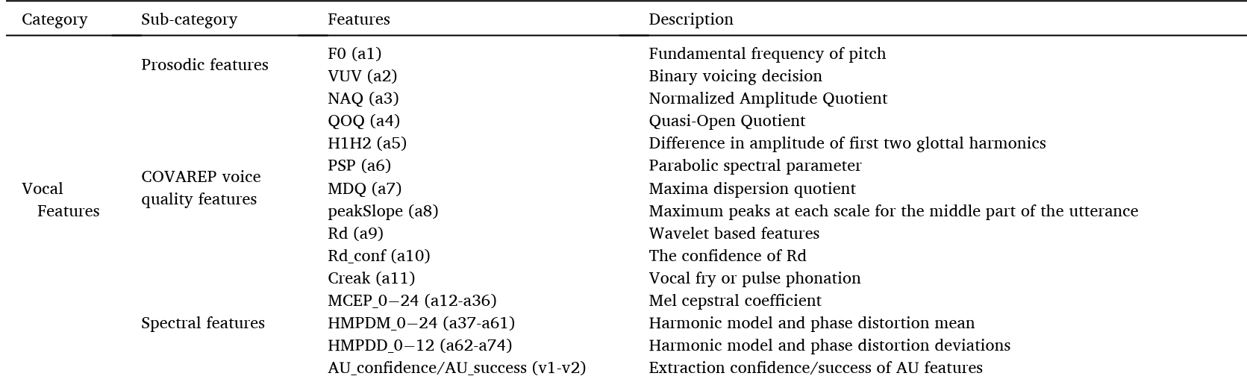
Vocal features + Visual features + Verbal features (created by the researchers)
Vocal features: three sub-categories
prosodic, voice quality, and spectral features.
Extracted by COVAREP

Slide 25
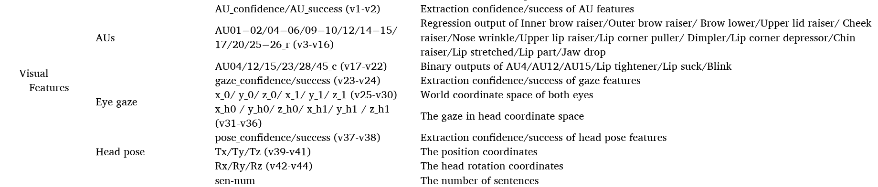
Visual features : three sub-categories
facial action units (AUs), eye gaze, and head pose
Extracted by OpenFace at a 66.67ms interval.

Slide 26
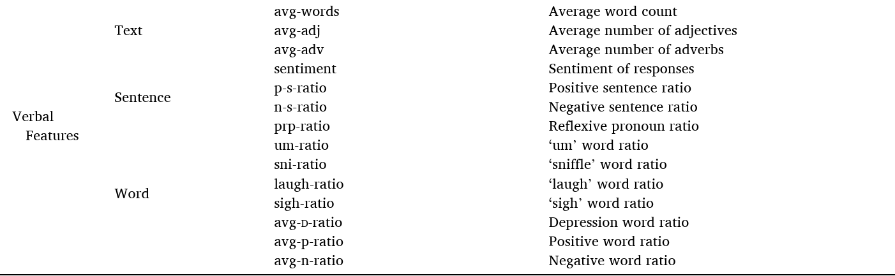
verbal features

Slide 27
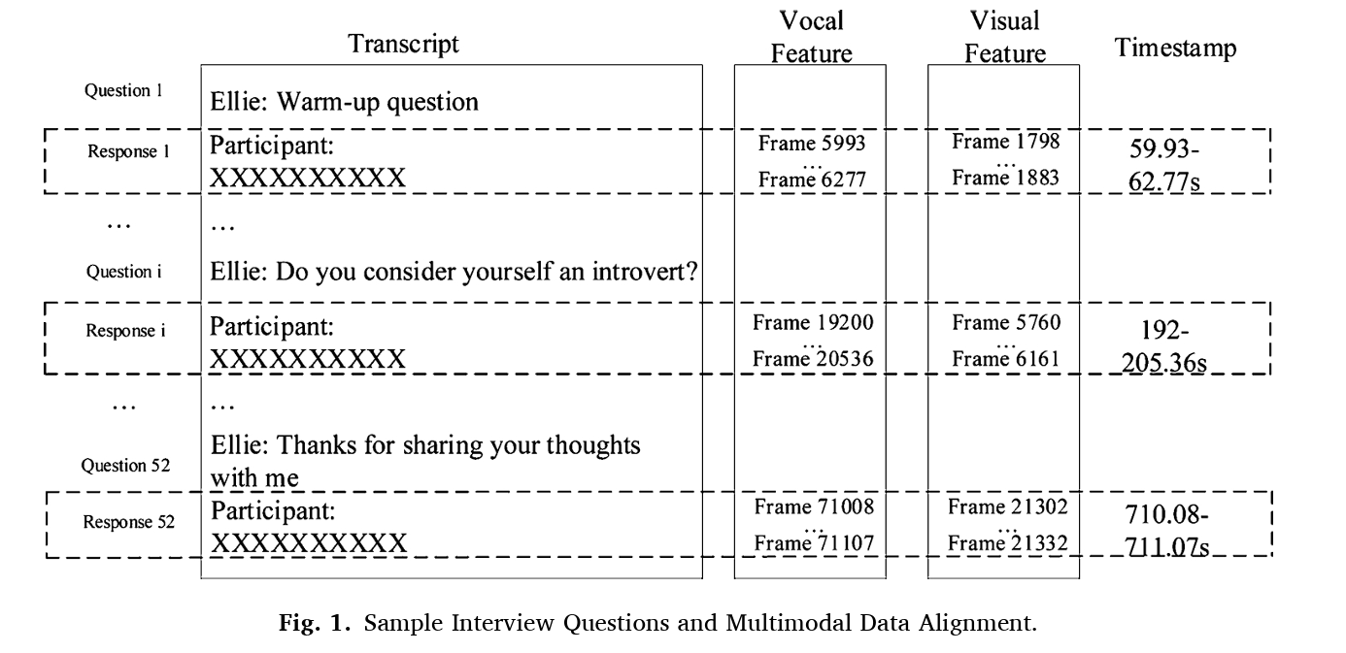
Question-level feature extraction
To support question-level analysis, they segmented the interview data by questions and aligned the multimodal data accordingly.

Slide 28
To categorize questions:
Three researchers independently analyzed the themes of all interview questions.
Among them, one had background in psychology; another had been
actively engaged in depression detection research for five years; and the third researcher was familiar with the DAIC-WOZ dataset.
The researchers then discussed and resolved non-overlapping themes among the three sets of results via a face-to-face meeting. They finalized the themes of the questions based on group consensus and generated nine question categories, including depression, therapy, problem, social relationship, military, personality, sleep, emotion, and conversation.

Slide 29
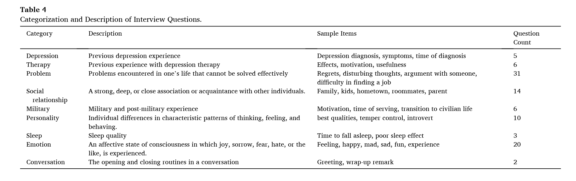

Slide 30
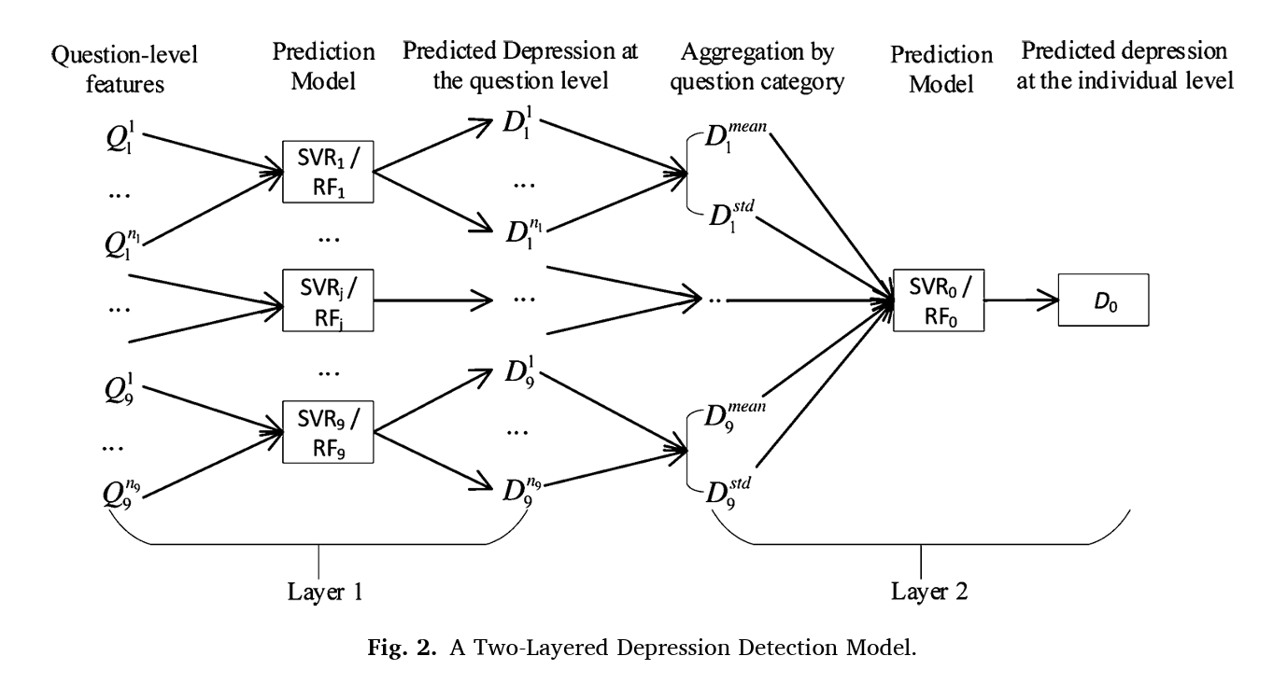

Slide 31
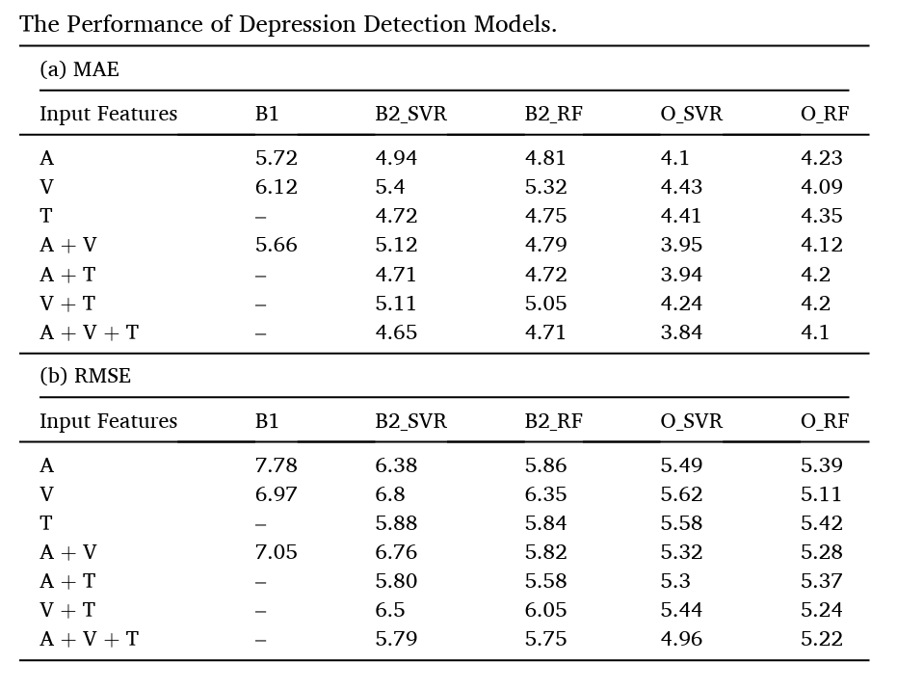
Baseline:
The first type of baseline (B1) models was Random Forest models that employed vocal features only, or visual features only,
or both vocal and visual (i.e., bimodal) features extracted from the same
data source.
B2_SVR and B2_RF models : developed with individual-level data, which aims to evaluate the effect of the proposed two-layered, question-level model. B2 incorporated the additional verbal features

Slide 32
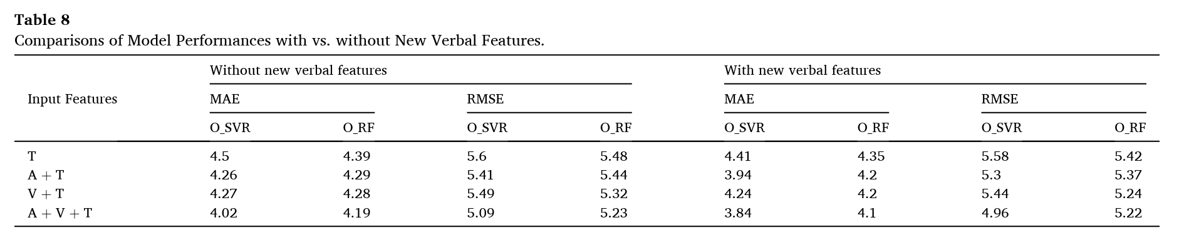

Slide 33
Related feature extraction code shared by the researchers:
https://github.com/Jackustc/Question-Level-Feature-Extraction-on-DAIC-WOZ-dataset

Slide 34
Plan for next 2 weeks
Try other parameter other than 40000, since there are indeed many files with more than 40000 pieces of data.
Discussed with Xiangyu and Yuxin about audio feature extraction
Try Xiangyu’s code using Matlab.

Slide 35
Depression Project Progress
Date: Mar 13
Name: Chen Yanru
University: Nanyang Technological University
Capstone Project Period: Jan-Dec 2024
MS in Data Science
Duration of the presentation:~10 minutes

Slide 36
Bailey, A., & Plumbley, M. D. (2021, August). Gender bias in depression detection using audio features. In 2021 29th European Signal Processing Conference (EUSIPCO) (pp. 596-600). IEEE.
This paper explores the potential gender bias in the DAIC-WOZ dataset and investigates methods to mitigate it.
The study compares the performance of deep learning models using mel-spectrogram features versus raw audio input and examines the impact of gender balancing techniques on classification accuracy.

Slide 37
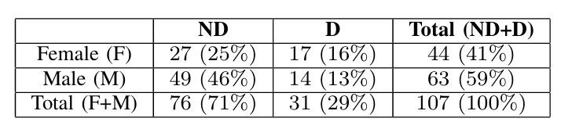
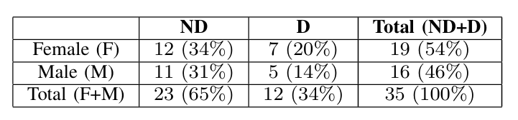
Gender Bias in DAIC-WOZ
Subdivisions of Training Set
Subdivisions of Validation Set
While the ratio of D:ND females is roughly 5:8, the ratio of D:ND males in the dataset is 2:7. Thus the frequency of individuals with depression in the dataset differs between genders, such that p(D | g = f) > p(D | g = m) where g is gender, f is female and m is male.
D: Depression
ND: Non-depression

Slide 38
Two ways to reduce gender bias
The paper hypothesises that features such as the mel-spectrogram used in models may emphasise pitch or vocal tract information that may be a proxy for gender, which could result in utilising the gender bias of DAIC-WOZ.
The number of training examples varies according to class (D:ND) and gender (female/male).
Raw Audio Model
Data sub-sampling to have equal data
Step 1: Split the training data into the
four quadrants: (f, D), (f, ND), (m, D), (m, ND).
Step 2: Randomly sub-sampled the audio signals from every quadrant with respect to the quadrant with the fewest examples, in this case 14 audio signals from depressed males (m, D).

Slide 39
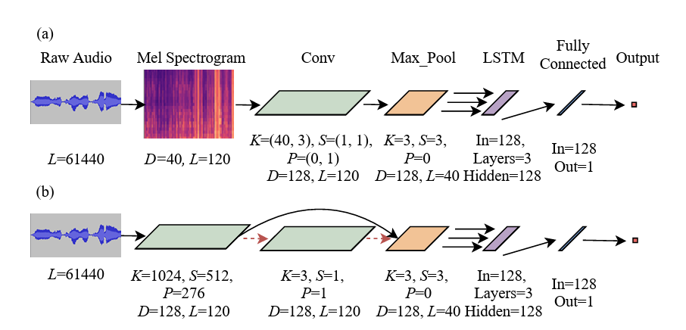
Model Architecture
The model is based on “DepAudioNet” of Ma et al.^{[2]}, which was one of the best models in AVEC 2016 to utilise deep learning with audio-only processing for depression detection.
D : depth (number of feature channels)
L : length
K : kernel size
S : stride length
P : zero padding
(a) shows the DepAudioNet architecture (after [2])
(b) shows raw audio model where the dotted red arrow shows an alternative network architecture with an additional convolutional filter.
Network architectures

Slide 40
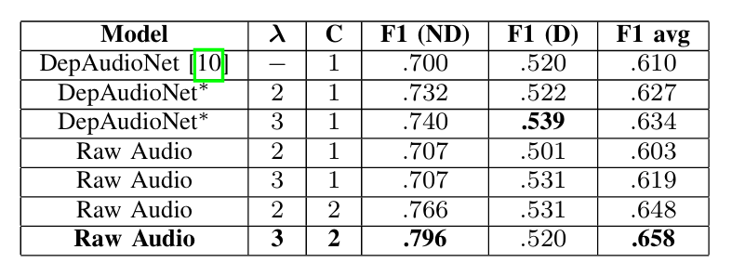
Results of Proposed Raw Audio Model & DepAudioNet Reproduction
:The rate of decay of the LR in epochs.
:The number of convolutional filters
REPORTED F1-SCORE RESULTS OF SEVERAL METHODS USING THE UNALTERED VALIDATION SET OF THE DAIC-WOZ DATASET.

Slide 41
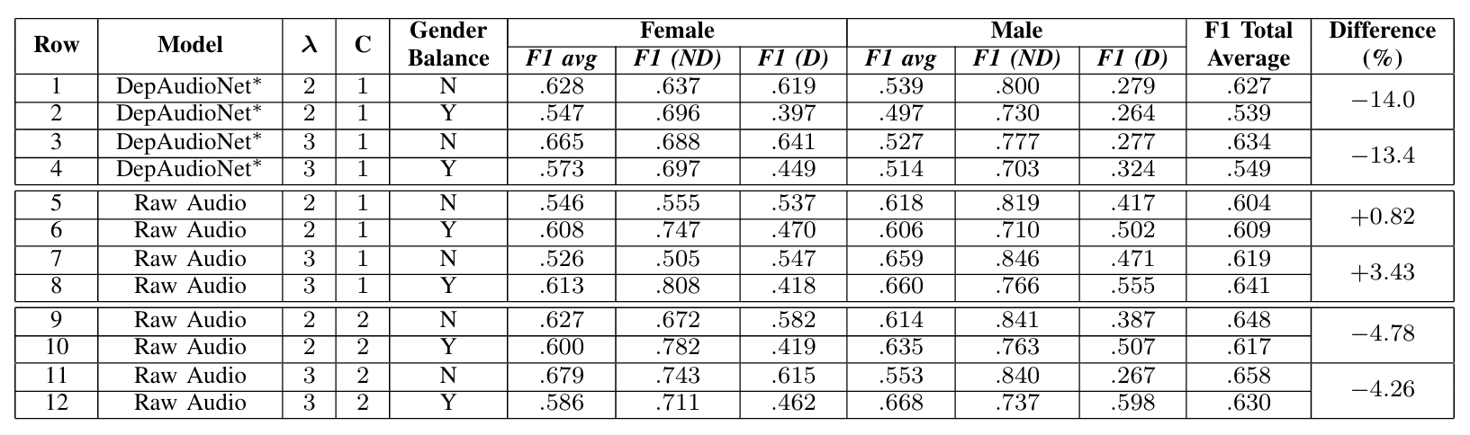
Results of Gender Balance

Slide 42
Key Findings:
The DAIC-WOZ dataset exhibits gender bias, which can lead to overreporting of performance in depression detection models.
Data re-distribution techniques, such as gender balancing, help mitigate gender bias and improve model fairness.
Raw audio input shows greater robustness to gender bias compared to mel-spectrogram features, leading to more accurate depression detection.

Slide 43
Plan for next week
Literature reviewing and organizing.
Discuss with Xiangyu and Yuxin about audio feature extraction
Try Xiangyu’s code using Matlab.

Slide 44
Depression Project Progress
Date: Mar 27
Name: Chen Yanru
University: Nanyang Technological University
Capstone Project Period: Jan-Dec 2024
MS in Data Science
Duration of the presentation:~18 minutes

Slide 45
He, L., Niu, M., Tiwari, P., Marttinen, P., Su, R., Jiang, J., ... & Dang, W. (2022). Deep learning for depression recognition with audiovisual cues: A review. Information Fusion, 80, 56-86.
cite: 100
This paper introduces the databases and describe objective markers for automatic depression estimation (ADE).
It reviews 114 studies for ADE from audio and visual cues, and selects 78 studies that adopt DL methods for ADE, and classifies them into (1) deep ADE networks for audio modality; (2) deep ADE networks for video modality (spatial feature ex_x0002_traction, temporal feature extraction); (3) deep ADE networks for audiovisual cues.
Lastly, this paper discusses challenges and promising directions related to the automatic diagnoses of depression using DL.

Slide 46
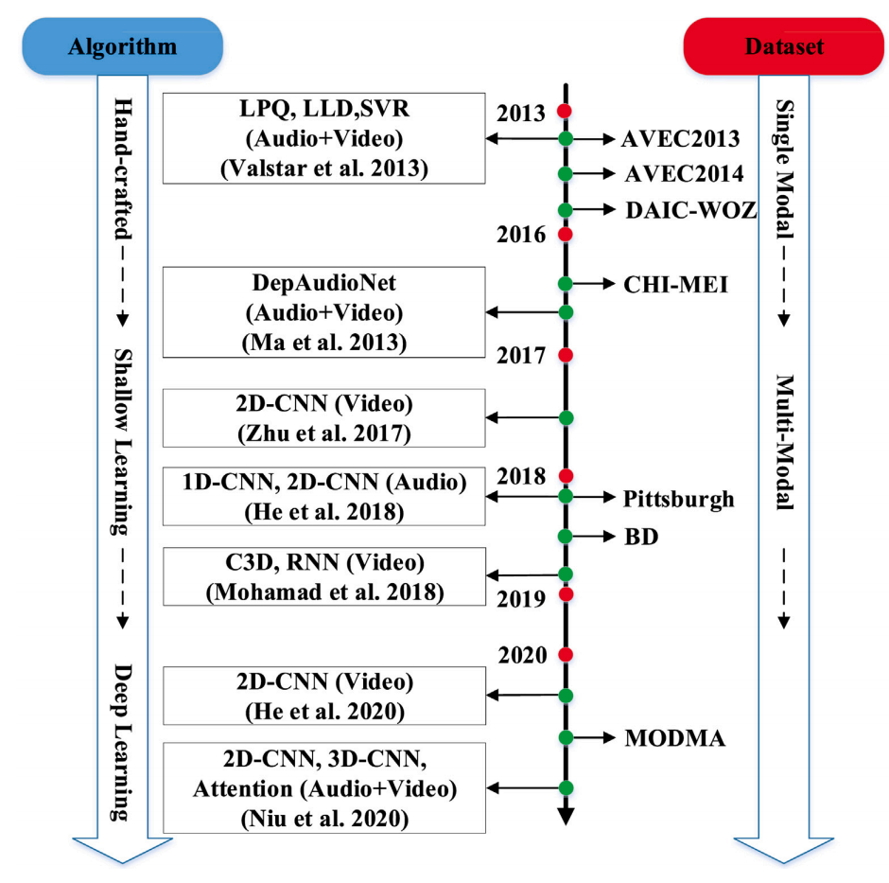
Audio or video data alone
Multiple types of data

Slide 47
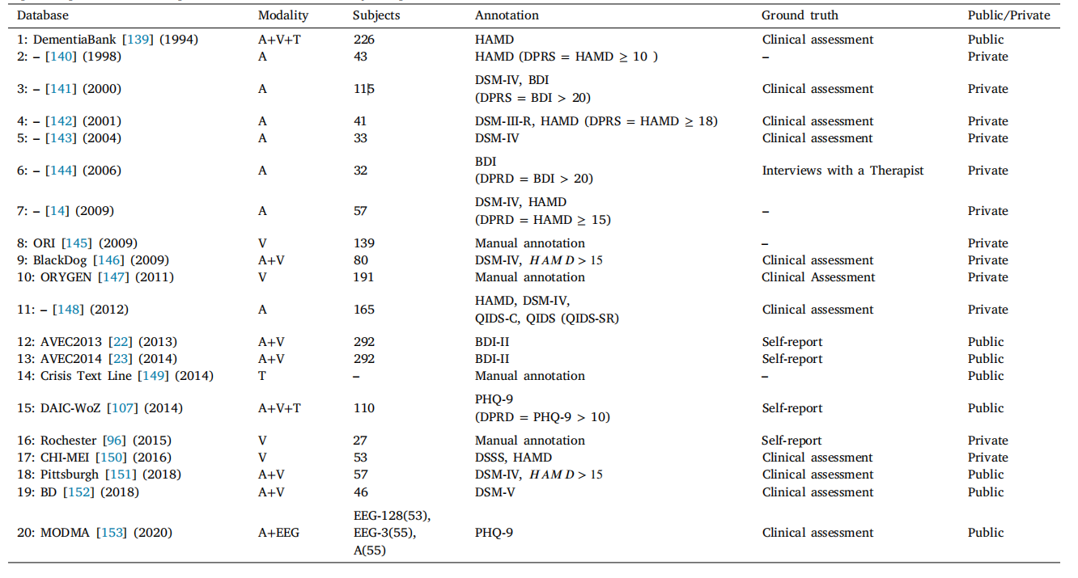
Summary of the Audiovisual databases which have been adopted in the reviewed works for the last 20 years

Slide 48
A two-stage literature search (IEEE Xplore, Springer Link, Web of Science, and ACM Digital Library) since 2013.
Stage 1 of our search yielded 480 studies.
In stage 2, we restricted the search to studies that adopted audio and visual cues for depression recognition. After that, we manually sorted the studies by shallow and DL methods, and obtained 114 studies related to depression.
Then we focused on the 78 studies considered in the present review that adopt DL for ADE. These selected studies are, for the purposes of this review, further classified by the modality (audio and video) based on DL for ADE in the following section.

Slide 49
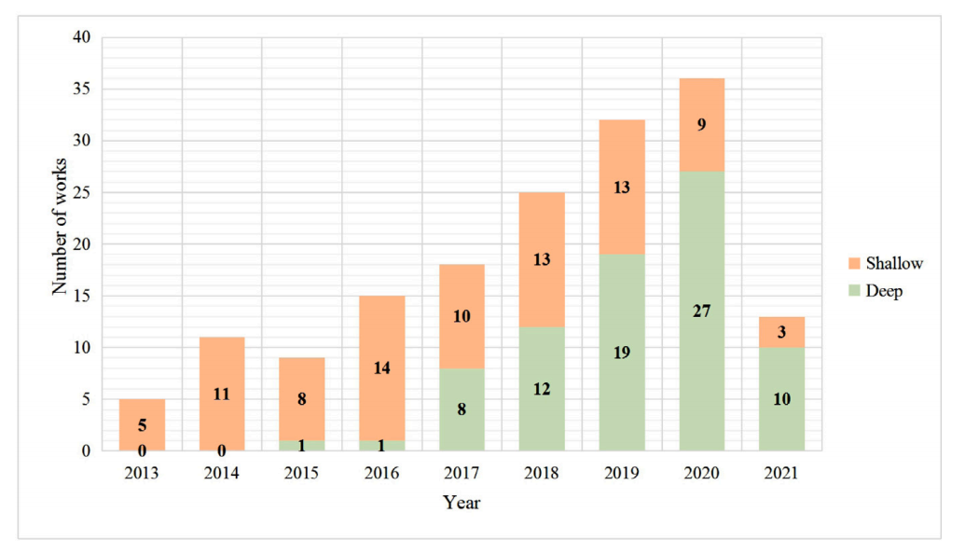
Studies that adopted audio and visual
cues for depression recognition.
DL for Automatic Depression Detection: 78
24 were published on audio modality

Slide 50
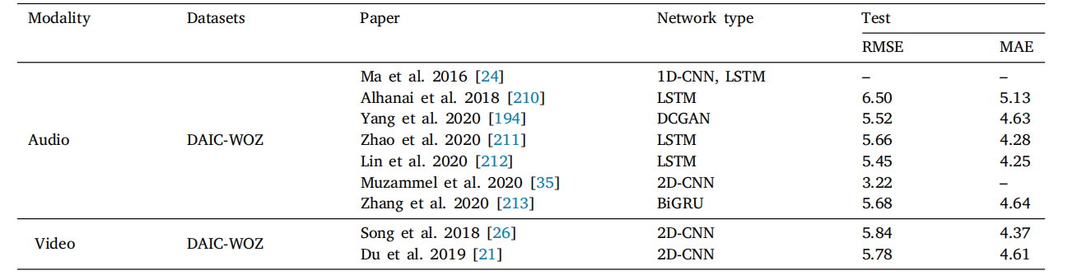
Summary of the performance of reviewed approaches with DAIC-WOZ

Slide 51
Rejaibi, E., Komaty, A., Meriaudeau, F., Agrebi, S., & Othmani, A. (2022). MFCC-based recurrent neural network for automatic clinical depression recognition and assessment from speech. Biomedical Signal Processing and Control, 71, 103107.
cite: 161
This paper presents a study on automatic clinical depression recognition and assessment from speech using a MFCC-based Recurrent Neural Network (RNN).
To overcome the problem of the small size of Speech Depression Recognition (SDR) datasets, expanding training labels and transferred features are considered in this paper.
Data augmentation + Transfer learning
Generalization to other dataset.

Slide 52
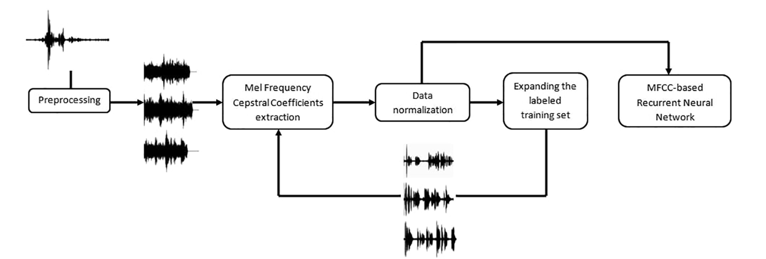
Experiment process
Low-level features
High-level features
Multi-features & channel

Slide 53
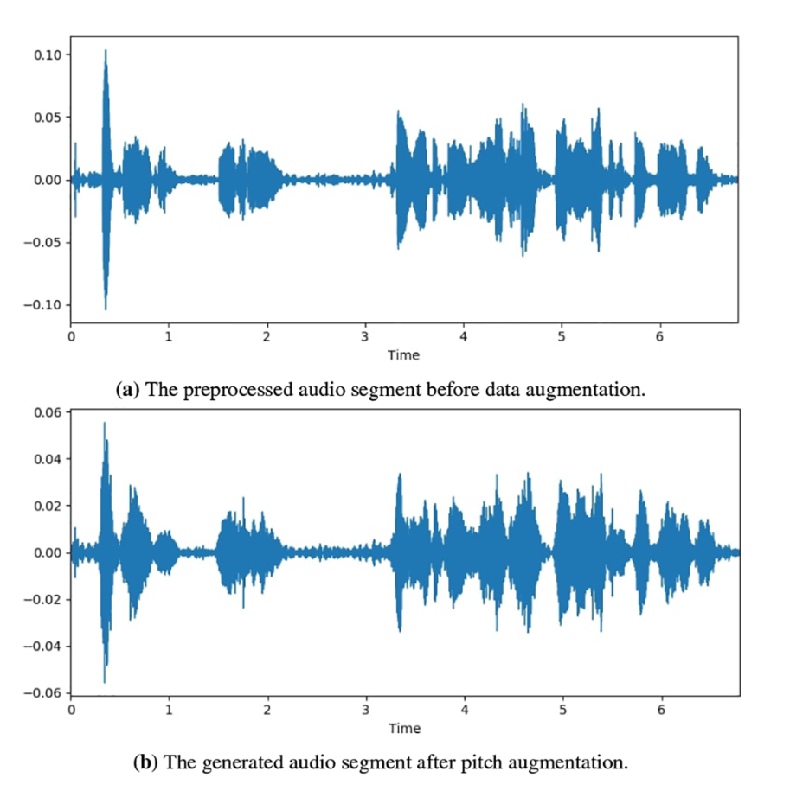
Data augmentation techniques
Noise Injection: adds random values into the data with a noise factor of 0.05.
Pitch Augmenter: randomly changes the pitch of the signal. The pitch factor is 1.5.
Shift Augmenter: randomly shifts the audio signal to left or right.
Speed Augmenter: stretches times series by a fixed rate with a speed factor of 1.5.

Slide 54
Transfer Learning
To transfer knowledge from an independent, yet related, previously learned task.
Pretrain the MFCC-based RNN model on a related task
Fine-tuning on the target task
Pretrained emotions recognition task with RAVDESS dataset
Fine-tuned depression recognition task with DAIC-WOZ dataset
The number of neurones of the third dense layers in the MFCC-based RNN model is modified and it is chosen to be as the number of emotions in the related task dataset.
Once the MFCC-based RNN is pretrained on the emotions recognition dataset, the optimum weights of the model are used as a starting point during the fine-tuning of the model on depression recognition dataset

Slide 55
RAVDESS dataset
It contains audio recordings of 24 actors expressing eight different emotions: 01-neutral, 02-calm, 03-happy, 04-sad, 05-angry, 06-fearful, 07-disgust, and 08-surprised.
The average length of the audio recordings within the dataset is five seconds. For each actor, 60 trials have been recorded. In each trial, the actor expresses one particular emotion. Each actor expressed the Neutral emotional state 4 times.
Total: 1440 trials
Emotional states (02 - 08): 192 trials per emotion
Neutral state: 96 trials
equally distributed

Slide 56
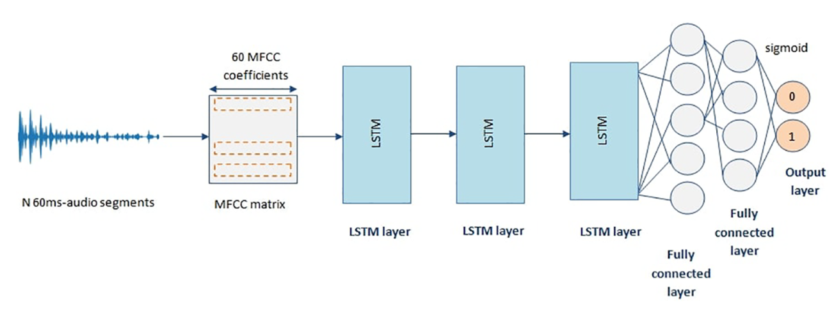
MFCC-based RNN Model structure
Pretrained with the emotions recognition task.
The last layer of the dense is of size eight neurones to predict the eight emotions classes.
After pretraining, the model is fine-tuned with the target task of depression assessment: the first three LSTM layers are frozen and the last three Dense layers are retrained.

Slide 57
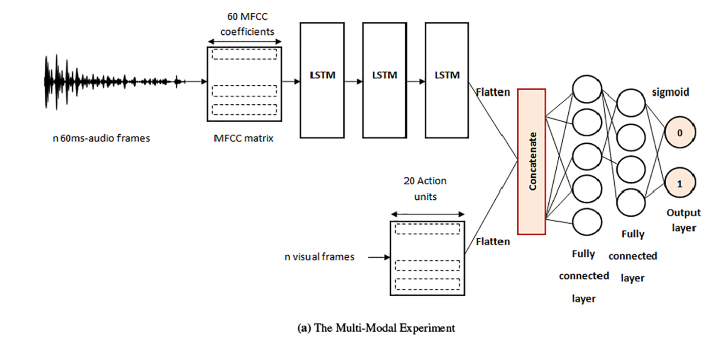
The multi-features experiment:
Combines 20 facial action units provided by the DAIC-WOZ corpus

Slide 58
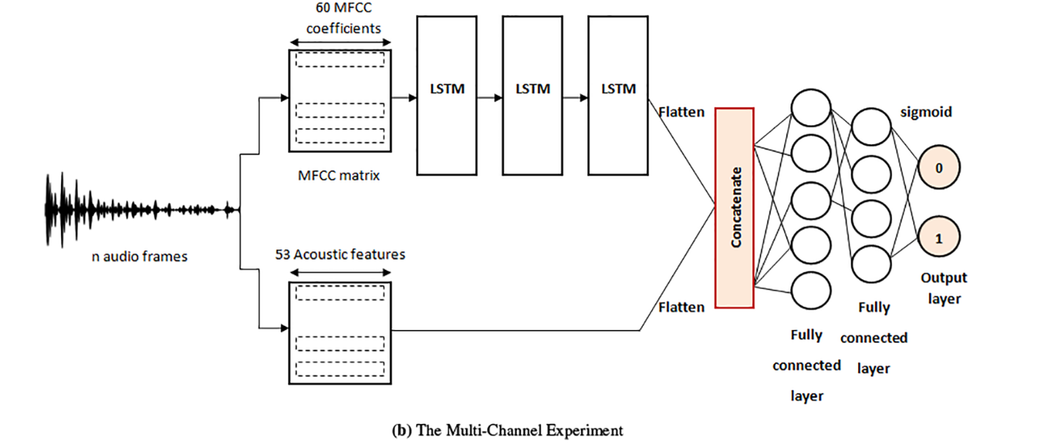
The multi-channels experiment:
Combines 53 acoustic features are extracted from audio frames windowed by 10 ms

Slide 59
Results of experiments
Models | Results | Accuracy | RMSE
MFCC-RNN (base) | Training set Validation set | 67.33% 67.61% | 0.5068 0.5057
MFCC-RNN (data augmentation) | Training set Validation set | 74.66% 74% | 0.4163 0.4206
MFCC-RNN (after transfer learning) | Training set Validation set | 77.21% 76.27% | 0.3991 0.4055

Slide 60
Results under depressed and non-depressed groups
Models | Class | Precision | Recall | F1-score
MFCC-RNN (base) | Non-Depressed Depressed | 78% 69% | 94% 35% | 85% 46%
MFCC-RNN (data augmentation) | Non-Depressed Depressed | 75% 70% | 95% 26% | 84% 38%
MFCC-RNN (after transfer learning) | Non-Depressed Depressed | 78% 69% | 94% 35% | 85% 46%
MFCC-RNN (adding 20% gaussian noise) | Non-Depressed Depressed | 73% 41% | 88% 21% | 80% 27%

Slide 61
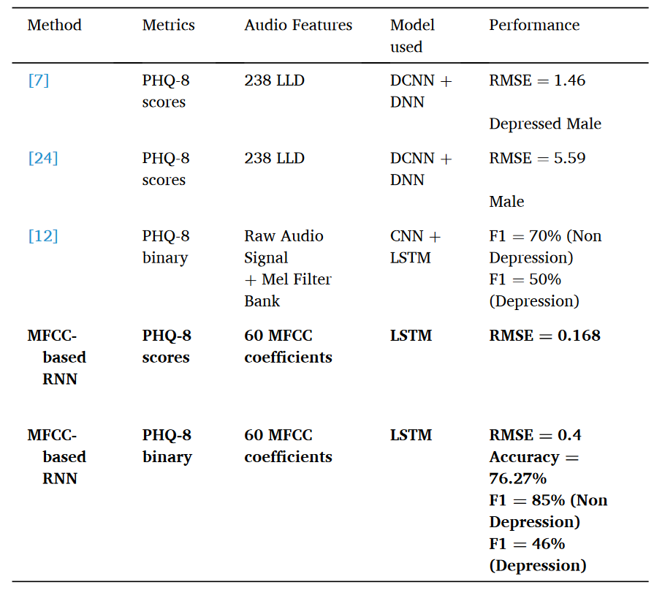
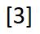
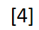
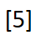
Comparison with other existing methods
[3] L. Yang, H. Sahli, X. Xia, E. Pei, M.C. Oveneke, D. Jiang, Hybrid depression classification and estimation from audio video and text information, in: Proceedings of the 7th Annual Workshop on Audio/Visual Emotion Challenge, ACM, pp. 45–51.
[4] L. Yang, D. Jiang, X. Xia, E. Pei, M.C. Oveneke, H. Sahli, Multimodal measurement of depression using deep learning models, in: Proceedings of the 7th Annual Workshop on Audio/Visual Emotion Challenge, ACM, pp. 53–59.
[5] X. Ma, H. Yang,Q. Chen, D. Huang, Y. Wang, Depaudionet: An efficient deep model for audio based depression classification, in: Proceedings of the 6th International Workshop on Audio/Visual Emotion Challenge, ACM, pp. 35–42.

Slide 62
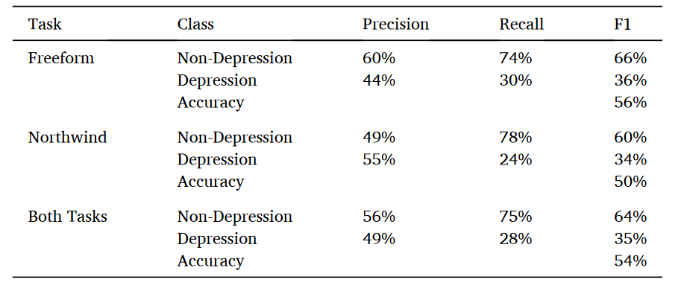
Generalization to AVi-D dataset - results
AVi-D dataset
The AVi-D dataset is depression and affects database. 300 audio recordings are collected from 292 participants who go through two different tasks:
Northwind task (reading task) and the Freeform task (answering questions).
Approximately, 150 audio recordings are available per task. The AVi-D corpus is based on the commonly used depression assessment test: The Beck Depression Inventory-II for assessing the severity levels of depression.
The audio recordings are labeled by the BDI-II scores ranging from 0 to 63. For a score below 14, the patient is labeled non-depressed.

Slide 63
Plan for next week
Literature reviewing and organizing - Data augmentation & ststistical models.
Jayawardena, S., Epps, J., & Ambikairajah, E. (2020). Ordinal logistic regression with partial proportional odds for depression prediction. IEEE Transactions on Affective Computing, 14(1), 563-577.
DAIC-WOZ and AViD

Slide 64
Depression Project Progress
Date: Apr 03
Name: Chen Yanru
University: Nanyang Technological University
Capstone Project Period: Jan-Dec 2024
MS in Data Science
Duration of the presentation:~13 minutes

Slide 65
Jayawardena, S., Epps, J., & Ambikairajah, E. (2020). Ordinal logistic regression with partial proportional odds for depression prediction. IEEE Transactions on Affective Computing, 14(1), 563-577.
This paper investigates proportionality structures and model selection for the design of ordinal regression systems within the logistic regression framework.
A new greedy-based algorithm for partial proportional odds model selection (GREP) is proposed that allows the parsimonious design of effective ordinal logistic regression models, which avoids an exhaustive search and outperforms model selection using the Brant test.
Evaluations on the DAIC-WOZ and AViD depression corpora show that OLR models exploiting GREP can outperform two competitive baseline systems (GSR and CNN), in terms of both RMSE and Spearman correlation.

Slide 66
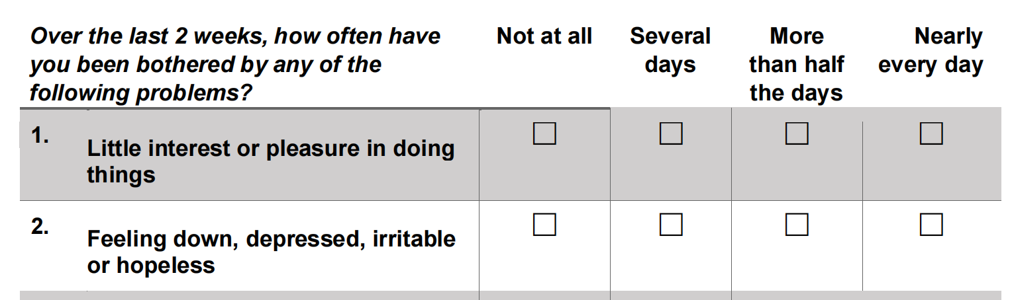
Reason to use ordinal logistic regression
Example of PHQ-8
The depression score is generated from a questionnaire evaluated on a Likert scale, hence the responses (sub-scores) are ordinal.
The final depression score, which is the summation of numerically interpreted sub-scores, is neither strictly ordinal nor strictly numerical.
Classification
Regression
Classification is for nominal response variables, where there is no relationship among classes: misclassification of an instance belonging to class severe depression to normal would be penalized equally to misclassifying the instance as mild depression, even when the former outcome is clearly more incorrect than the latter.
Regression is applied to numerical response variables, typically in this setting to predict the depression severity as a numerical score (e.g., Beck Depression Inventory, Patient Health Questionnaire

Slide 67
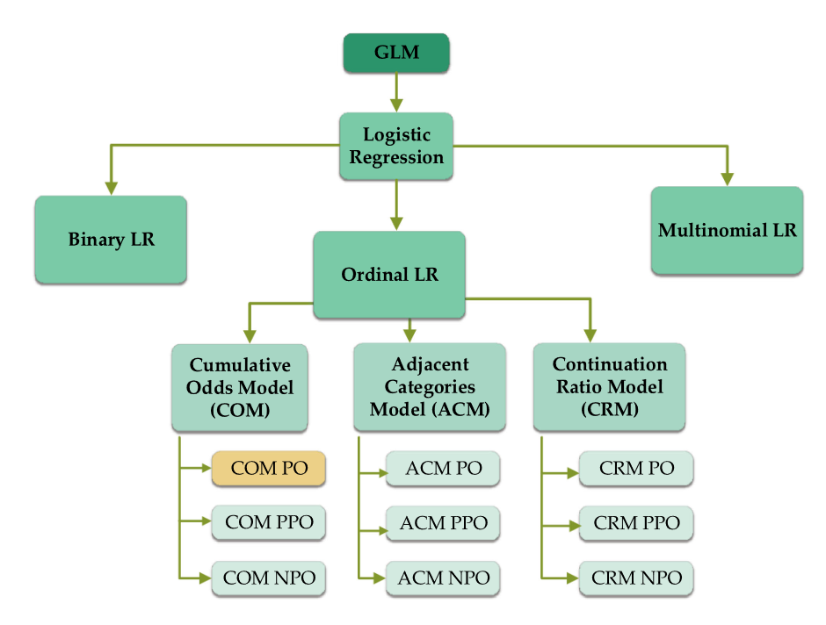
PO - Proportional Odds
PPO – Partial Proportional Odds
NPO – Non-Proportional Odds
COM PO, coloured in yellow, is the most common ordinal logistic regression model.
Family tree of ordinal logistic regression.

Slide 68
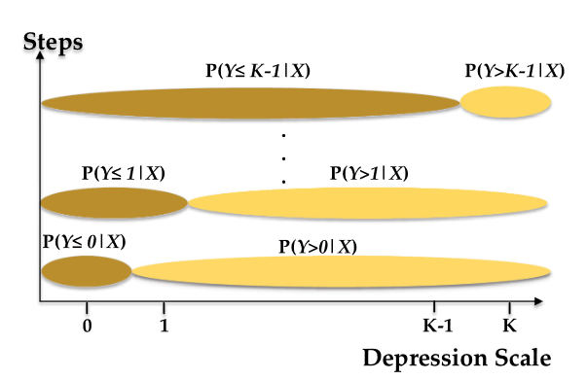
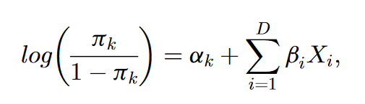
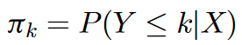
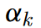
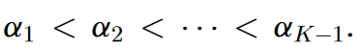
Proportional Odds (PO) Assumption
Cumulative-Odds Model (COM)
PO structure for COM
represents the probability of a depression score being less than or equal to the score value k
K is the maximum value in the target scale range. Intercept satisfies the condition

Slide 69
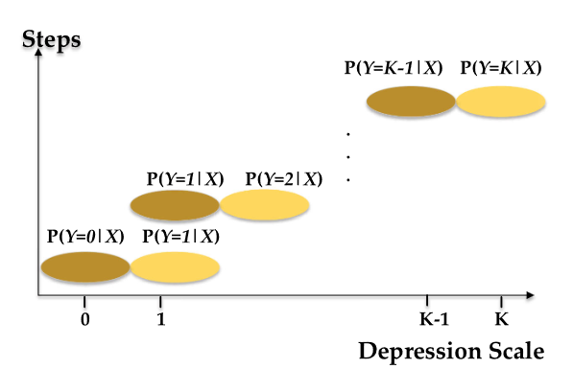
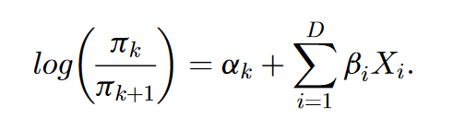
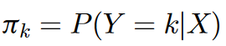
Proportional Odds (PO) Assumption
Adjacent-Category Model (ACM)
PO structure for ACM
is the probability of depression score being k.
Hence, this model does not use all data at every step.
ACM is more appropriate when the categories of the response variable are substantive, such as when comparing the depression severity of multiple patients.

Slide 70
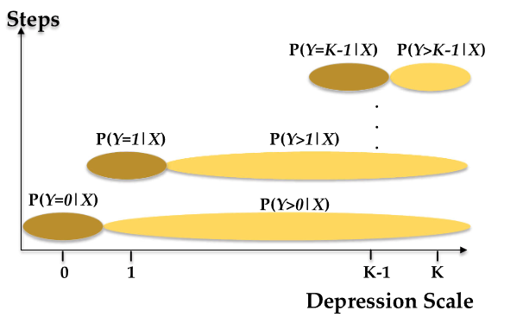
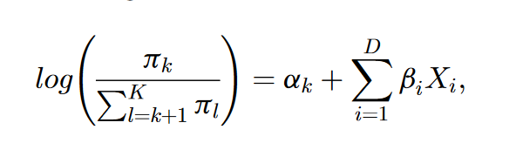
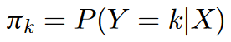
Proportional Odds (PO) Assumption
Continuation-Ratio Model (CRM)
PO structure for CRM
is the probability of depression score being k,
which is compared against the probability of depression score being in a higher level than k.
Similarly to ACM, CRM does not use the full dataset at each step: it ignores the data that are in lower categories than severity level k

Slide 71
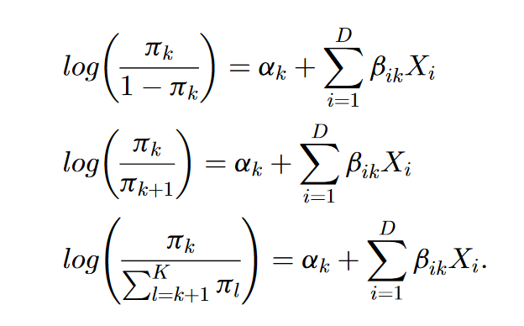
Non-Proportional Odds (NPO)
NPO structure for COM
NPO structure for ACM
NPO structure for CRM

Slide 72
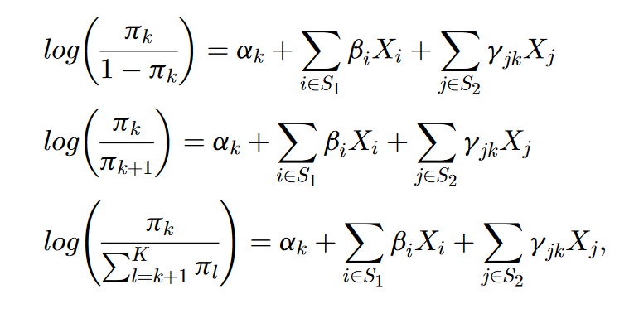
Partial-Proportional Odds (PPO)
PPO structure for COM
PPO structure for ACM
PPO structure for CRM

Slide 73
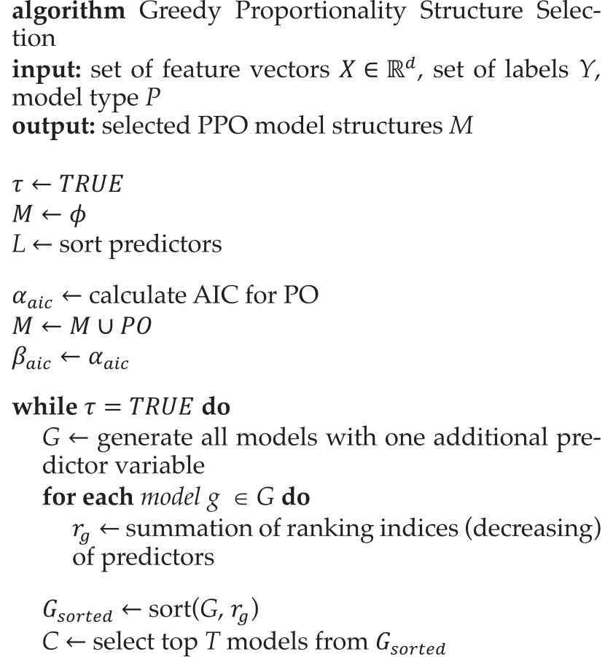
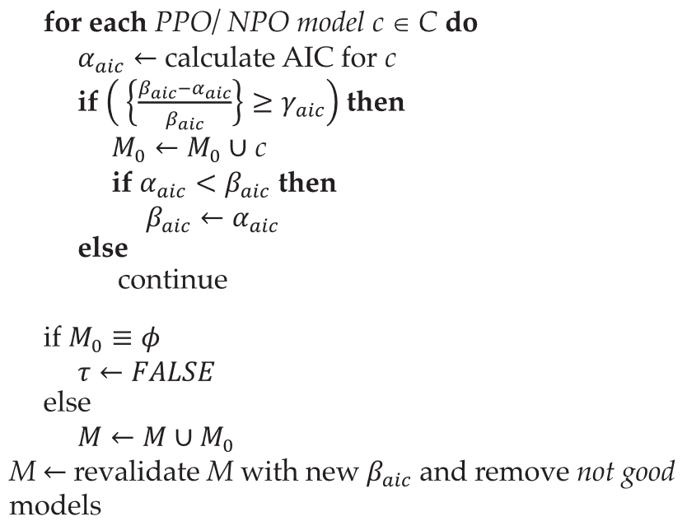
GREP: Proposed Greedy Proportionality Structure Selection

Slide 74
PPO model selection using GREP
Selected Proportionality Configuration
Calculate standard deviations of the coefficients of the augmented model
Evaluate PPO configurations
Sort predictor varieables according to descending order of standard deviations
Revalidate output PPO list according to the new baseline
Set PO as baseline
Update baseline
Evaluate PPO configurations and select those that are comparatively better than the baseline
Generate PPO configurations with one additional predictor variable
Sort models
Select top T models

Slide 75
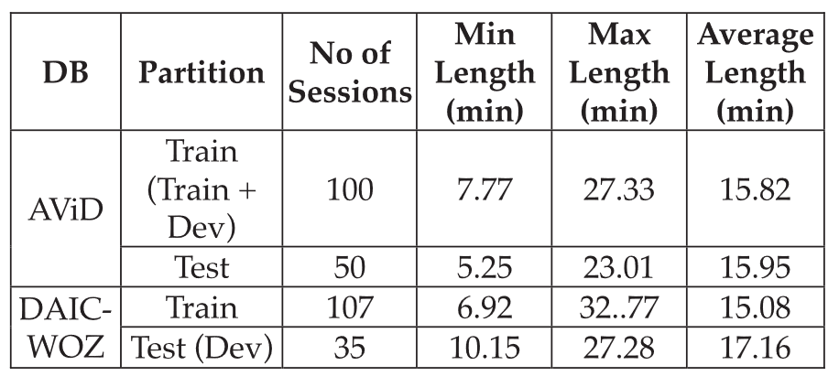
Summary of Speech Depression Databases Used
Experiment followed the following groupings to train the models:
DAIC-WOZ (PHQ-8): 0-1, 2-4, 5-9, 10-14, 15-19, 20-24
AViD (BDI): 0-1, 2-3, 4-5, 6-7, 8-10, 11-13, 14-20, 21-26, 27-38, 39-63.
Experiment combined the original training and development partitions of AViD in order to get a much bigger training dataset.

Slide 76

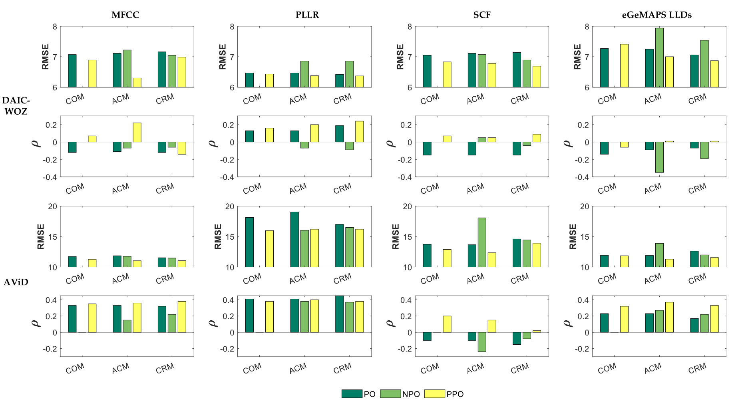
Comparison of Different Ordinal Logistic Regression Models Using Depression Corpora
:Speraman correlation

Slide 77

Comparison of Depression Prediction Accuracy (RMSE and Spearman’s Correlation) of Ordinal Logistic Regression With Proposed GREP Model Selection and Baseline Systems (GSR and CNN)

Slide 78
Plan for next week
Discuss with Xiangyu and continue to do literature review - Statistical model

Slide 79
Depression Project Progress
Date: Apr 24
Name: Chen Yanru
University: Nanyang Technological University
Capstone Project Period: Jan-Dec 2024
MS in Data Science
Duration of the presentation:~18 minutes

Slide 80
Huang Z, Epps J, Joachim D. Investigation of speech landmark patterns for depression detection[J]. IEEE transactions on affective computing, 2019, 13(2): 666-679.
This paper investigated speech landmark patterns for depression detection.
It proposed two sets of novel features based on speech landmarks and evaluated their effectiveness on two different datasets: the DAIC-WOZ dataset, and the SH2 dataset.
This article proposes two feature sets associated with speech articulation events based on counts and durations of sequential landmark groups or n-grams.

Slide 81
Speech Landmarks
Speech landmarks are event markers associated with articulation of speech.
They rely solely on the location of acoustic events in time, commonly occurring at times of consonant closures/releases, nasal closures/ releases, glide minima and vowel maxima, thereby providing information about articulatory events (e.g., vibration of the vocal folds).
By contrast with the frame-based processing framework and independent of frames, landmark methods characterize articulatory elements of speech, and detect timestamp boundaries denoting sharp changes in speech articulation.

Slide 82

Six Landmarks adopted in this paper
‘g(lottis)’, ‘p(eriodicity)’, ’s(onorant)‘, ‘f(ricative)’, ‘v(oiced fricative)’, ‘b(ursts)’
Essentially specify points in time at which different abrupt articulatory events occur
They are detected once certain evidence of rapid changes (i.e., rises or falls) in power across multiple frequency ranges and multiple time scales is observed.

Slide 83

Example of Landmarks
Points around which articulatory information can be extracted, which thereby is useful to detect changes in motor coordination due to, more deeply about the motor planning, working memory and integration of auditory and proprioceptive feedback.
These things are varied due to different speaking style, health status, or mental operation.^{[1]}
Feature extraction of the landmark count-based and durationbased features from the word ‘PaTaKa’uttered by a male depressed speaker within 1.5 seconds.
[1] S. Boyce, H. J. Fell, and J. MacAuslan, “SpeechMark: Landmark detection tool for speech analysis,” in Proc. INTERSPEECH, 2012, pp. 1894–1897.

Slide 84




Landmark Count Features

Slide 85



Landmark Duration Features
Explores the timing information embedded in landmarks.
Statistics calculated from two types of bigrams, i.e., arbitrary consecutive bigrams and onset-offset pairs.

Slide 86


P Values comparing the Distributions of Onset-Offset Pair Durations between Depressed and Healthy Speakers
P values on Training Data Partitions, Comparing the Distributions of Consecutive Bigram Durations between Depressed and Healthy Speakers

Slide 87

Experiment
All experiments in this study adopted a linear Support Vector Machine (SVM) classifier
Statistics were calculated from the durations of consecutive bigrams and onset-offset pairs for each audio file, and used as features to classify depression and non-depression.

Slide 88
Optimized results
Examined two fusion schemes at decision levels
The first fusion scheme linearly combines SVM scores (distance to the optimum hyperplane of the trained model) before calculating the ‘sign’ for binary decisions.
The second fusion scheme fuses duration, count, and acoustic features via majority voting of the binary decisions from each individual system for each speech file.

Slide 89

The achievement of the landmark duration features is significant, because exploiting the audio modality for DAIC has been more challenging than other modalities, and the text modality has dominated the performances on this particular dataset [63], [58], [60].
It is also worth noting that the duration feature set achieved 100 percent accuracy on the training partition, correctly classifying 21 depressed and 86 healthy speakers. As a result, fusion was not found to yield further gains.

Slide 90

SH2 Dataset ^{[2]}
Data were collected from an interactive app running on
Android™ smartphones. The app, created by Sonde Health, was designed to elicit and collect speech samples along with questionnaires, including the Patient Health Questionnaire (PHQ-9), a validated instrument that measures risk for depression.
Participants completed several voice tasks on their
personal smartphones in uncontrolled natural environments.
Six tasks (i.e. sustained vowel, diadochokinetic, free speech, rainbow passage, cognitive load and sentence)
Partial screenshots of the Sonde Health
smartphone speech elicitation app.
[2] Huang, Z., Epps, J., Joachim, D., & Chen, M. (2018, September). Depression Detection from Short Utterances via Diverse Smartphones in Natural Environmental Conditions. In INTERSPEECH (pp. 3393-3397)

Slide 91

A subset of the collected data, which we refer to as the SH2
dataset.
SH2 contains around 16 hours of speech for 887 participants (436 female and 450 male). The 5937 total audio files comprise six tasks, completed by 498 to 810 participants.
The SH2 dataset also includes a wide variety of mobile device and smartphone manufacturers (28 in total)

Slide 92

SH2 (Free Speech)
Evaluates the proposed count-based and duration-based features for other five tasks on the SH2 corpus, namely diadochokinetic (‘Word’), rainbow passage (‘Passage’), cognitive load (‘CL’), sustained vowels (‘Utterance’), and Harvard sentences (‘Sentence’).

Slide 93
Findings
The landmark count and especially duration features are effective for depression detection on DAIC-WOZ and SH2(FS), two dramatically different datasets.
The difference in performance between DAIC-WOZ and SH2:
1) DAIC-WOZ has clean speech collected from a high quality microphone, whereas SH2 contains noisy speech collected in the wild from smartphones with diverse channel characteristics.
2) DAIC-WOZ has longer speech durations than SH2 (FS), which result in more reliable estimates of the distributions of speech duration.
For linear SVM
Further examined the best proposed duration-based landmark features on:
Random Forest
Neural Networks

Slide 94
EATD-CORPUS (in Chinese)
Two publicly available datasets referring to depression detection:
DAIC-WOZ
AViD: German & the transcripts are not provided by the authors.
Shen, Y., Yang, H., & Lin, L. (2022, May). Automatic depression detection: An emotional audio-textual corpus and a gru/bilstm-based model. In ICASSP 2022-2022 IEEE International Conference on Acoustics, Speech and Signal Processing (ICASSP) (pp. 6247-6251). IEEE.

Slide 95

Data collection
An APP, through which a virtual interviewer will ask the interviewee three questions, is developed to conduct
the interview and to collect audio responses. The interviewees can record their responses and upload the response audios online.
Besides, each volunteer is required to complete an SDS questionnaire, the score of which indicates the depression severity.
Currently, 162 volunteers have successfully finished online interviews. Based on their SDS scores, 30 volunteers are regarded in depression and the other 132 volunteers are non-depressive.
For Chinese people, an index SDS score (i.e. raw SDS score×1.25) greater than or equal to 53 implies that he/she is in depression.

Slide 96
Data preprocessing
First, mute audios, audios less than 1 second, and the silent segments at the beginning and the end of each recording are removed.
Then the background noises are eliminated using RNNoise with default parameters.
After that, Kaldi is used to extract transcripts from the audios.
In the end, all the transcripts were manually checked and corrected.

Slide 97


Training set : 83 volunteers (19 D + 64 ND)
Validation set : 79 volunteers (11 D + 68 ND)
/t1/negative.txt:
duration of wav - 0:26 seconds
The overall duration of response audios in the dataset is about 2.26 hours.

Slide 98
Plan for next week
Try to use statistical methods/basic ML for DAIC-WOZ
Continue with Mindmap
Extract MFCC features
Investigate other dataset (EATD-Corpus)

Slide 99
Depression Project Progress
Date: May 08
Name: Chen Yanru
University: Nanyang Technological University
Capstone Project Period: Jan-Dec 2024
MS in Data Science
Duration of the presentation:~8 minutes

Slide 100
DAIC-WOZ
Data Augmentation
SPECTRO & MFCC Features extraction
Concatenate Model

Slide 101
Data Augmentation
nlpaug.augmenter.audio
pitch augmentation
pitch_factors = [0.5, 0.8, 1.0]
Augmented data: 189*3 = 567
noise augmentation
noise_factors = [0.03, 0.02, 0.01]
Augmented data: 189*3 = 567
Audio Data files
Original: 189
After Augmentation: 567 + 567 + 189 = 1323

Slide 102

Feature Extraction
Audio file - Generate SPECTROGRAM & resize
SPECTROGRAM Feature
MFCC Features
8:2 train & valid
Spectrogram image resize to (224,224)
SPECTRO_ReCoLa.pkl
One-hot encoding num_classes set as 10
MFCC_ReCoLa.pkl
Audio File Threshold
set as 177

Slide 103
Model Structure
Model 1 - SPECTRO Feature
Input layer
CNN Layers
CNN Layers
CNN Layers
Flatten
(224,224,4)
2 2d-Convolutional layers:
128 filters, with kernel sizes of (3,3).
Dropout
2d-Maxpooling
3 2d-Convolutional layers:
128 filters, with kernel sizes of (3,3).
Dropout
1 2d-Convolutional layers:
128 filters, with kernel sizes of (3,3).
Dropout
2d-Maxpooling

Slide 104
Model Structure
Model 2 - MFCC Feature
Input layer
CNN Layers
Dropout
Maxpooling
Flatten
(177,1)
2 1d-Convolutional layers:
128 filters, with kernel sizes of 5.

Slide 105

Model Structure
Concatnate 2 models
CNN MFCC based output
CNN Spectrograms output
Softmax - Prediction

Slide 106
Results
Epochs | Accuracy | Precision | Recall | F1-Score
20 | 62.70%
40 | 73.37% | 72.08% | 58.04% | 55.81%
60 | 76.11% | 77.77% | 62.67% | 62.37%
80 | 78.31% | 79.23% | 62.97% | 62.69%
100 | 80.02% | 74.54% | 66.08% | 66.95%

Slide 107
SVM on original dataset
Results
cross validation
cv = 5-FOLDS
Parameters | Accuracy | Precision | Validation | F1-Score
c: 1 gamma: 0.01 kernel: rbf | Train: 93.5% Test: 64.45% | Train: 100% Test: 70% | Train: 87.3% Test: 29% | Train: 92.2% Test: 38.37%

Slide 108
Plan for next week
Continue with Mindmap
& Literature Review

Slide 109
Depression Project Progress
Date: May 29
Name: Chen Yanru
University: Nanyang Technological University
Capstone Project Period: Jan-Dec 2024
MS in Data Science
Duration of the presentation:~6 minutes

Slide 110
Results
size | Accuracy | Precision | Recall | F1-Score
train: 749 val: 245 test: 329 | train: 0.7174 val: 0.7196 test: 0.5106 | val: 0.33 | val: 0.50 | val: 0.40
train: 1078 val: 245 | train: 0.90 val: 0.7199 | val: 0.38 | val: 0.52 | val: 0.44
train: 1058 val: 265 | val: 0.8002 | val: 0.7454 | val: 0.6608 | val: 0.6695
Original
train+test
randomly
split

Slide 111


Summited on 17 Feb 2024
When LLMs Meets Acoustic Landmarks: An Efficient Approach to Integrate Speech into Large Language Models for Depression Detection
Xiangyu Zhang, Hexin Liu, Kaishuai Xu, Qiquan Zhang, Daijiao Liu, Beena Ahmed, Julien Epps
https://arxiv.org/abs/2402.13276
Landmarks + LLM
Landmark extraction (as Table 1)
Data Augmentation (adopted from Wu et al.[1] (2023)) : augmenting the training set through sub-dialogue shuffling. - to balance the number of positive and negative samples effectively, while substantially increasing the dataset size.
[1] Wen Wu, Chao Zhang, and Philip C Woodland. 2023.Self-supervised representations in speech-based depression detection.In ICASSP 2023-2023 IEEE International Conference on Acoustics, Speech and Signal Processing (ICASSP), pages 1–5. IEEE.

Slide 112

Experiment results
In the table, M denotes the number of augmented sub-dialogues per dialogue in our data augmentation algorithm, while the previous SOTA used M=1000 sub-dialogues.
A comparison of our proposed system with previous state-of-the-art (SOTA), where all ensemble outcomes(F1 Score) are derived from a majority vote.
[1] Wen Wu, Chao Zhang, and Philip C Woodland. 2023.Self-supervised representations in speech-based depression detection.In ICASSP 2023-2023 IEEE International Conference on Acoustics, Speech and Signal Processing (ICASSP), pages 1–5. IEEE.

Slide 113
Literature Review
Definition of Depression (or MDD)
Definition: Summerized from WHO
https://www.who.int/news-room/fact-sheets/detail/depression
Neuroscientific research definition, symptoms and patterns:
Beck, A. T., Steer, R. A., Brown, G. K. et al. Beck depression inventory. (1996).
Kaltenboeck, A. & Harmer, C. The neuroscience of depressive disorders: A brief review of the past and some considerations about the future. Brain Neuroscience Advances 2, 2398212818799269 (2018).

Slide 114
Plan for next week
Try Lightgbm
Investigate transfer learning
Literature Review:
Evaluation Metrics
Audio Signals Pre-processing and Feature Extraction

Slide 115
Depression Project Progress
Date: June 5
Name: Chen Yanru
University: Nanyang Technological University
Capstone Project Period: Jan-Dec 2024
MS in Data Science
Duration of the presentation:~10 minutes

Slide 116
Audio Signals Pre-processing and Feature Extraction
Signal Pre-processing Stage
1. Separation of Signal Boundaries: This step ensures that each segment contains relevant information for feature extraction.
2. Digital Filtering: To remove noise, enhance signal quality, and prepare the data for further processing.
3. Segmentation: Dividing the speech signal into smaller frames or segments to facilitate feature extraction.
4. Application of a Smoothing Window: To reduce spectral leakage and improving the frequency analysis of each segment.

Slide 117
Audio Signals Pre-processing and Feature Extraction
Audio Feature Extraction Stage
Physical audio feature extraction techniques
Perceptual audio features extraction techniques

Slide 118
Audio Feature Extraction Stage
Physical audio feature extraction techniques
1. Time Domain Features:
- Examples: Zero Crossing Rate, Energy, Root Mean Square (RMS) Energy.
2. Frequency Domain Features:
- Examples: Spectral Centroid, Spectral Flux, Spectral Roll-off.
3. Wavelet Domain Features:
- Examples: Wavelet Coefficients, Wavelet Entropy, Wavelet Packet Energy.
4. Image-Based Features:
- Examples: Mel-frequency Cepstral Coefficients (MFCCs), Chroma Features.
5. Cepstral Domain Features:
- Examples: Mel-frequency Cepstral Coefficients (MFCCs), Perceptual Linear Prediction (PLP) Coefficients.
6. Other Domain Features:
- Examples: Teager Energy Operator, Group Delay Function, Pitch-based Features.

Slide 119
Audio Feature Extraction Stage
Perceptual audio features extraction techniques
1. Zero-Crossing Rate-Based Features:
Zero-crossing rate features analyze the rate at which the signal changes polarity.
- Examples: Zero-Crossing Rate, Zero-Crossing Peak Amplitudes (ZCPA).
2. Autocorrelation-Based Features:
Autocorrelation-based features analyze the correlation of a signal with delayed versions of itself.
- Examples: Perceptual Autocorrelation Features.
3. Rhythm Pattern Features:
Rhythm pattern features capture temporal patterns and rhythmic structures in audio signals.
- Examples: Beat Histograms, Tempo Estimation Features.

Slide 120
Transfer Learning - DAIC-WOZ
Article | Features | Metrics | Methods
Pingyue Zhang et al. | MFCC, LMS, LLD, CVP, STFT | Classification: Pre, Rec, F1 Regression: MAE, RMSE | Pretrains DEPA using a self-supervised learning approach with an encoder-decoder model
Ziping Zhao et al. | Mel-spectra | MAE, RMSE | This transfer is applied in a two-level hierarchical network which mirrors the natural hierarchical structure of speech
Vandana et al. | MFCC, COVAREP and Mel Spectrograms | Pre, Rec, F1, Acc | This paper utilizes transfer learning by leveraging a pretrained model for text features in the proposed hybrid model for depression detection.
Amir Harati et al. | Mel-spectrograms | F1 | The paper utilizes a pre-trained model, specifically the Wav2vec2.0 model and adversarial speaker-invariant training
Zhiyong Wang | MFCC, Entropy Characteristics of Spectrogram | MAE, RMSE | Multi-scale audio difference normalization algorithm is used to obtain the feature V2, which expresses the depressive change characteristics of the previous audio.

Slide 121



DEPA - an auditory feature extracted via a neural network to summarize spoken language.
The model is designed to predict and reconstruct a center spectrogram within a sequence of 2𝑘 + 1 spectrograms
Data Used for Pretraining:
In-Domain: DAIC-WOZ (13hrs, ENG) & MDD (411hrs, CHN)
Out-Domain Data: SWB (300hrs, ENG) & AD (400hrs, CHN)
Zhang P, Wu M, Dinkel H, et al. Depa: Self-supervised audio embedding for depression detection[C]//Proceedings of the 29th ACM international conference on multimedia. 2021: 135-143.

Slide 122


DEPA - an auditory feature extracted via a neural network to summarize spoken language.
The proposed method consists of a self-supervised convolutional encoder-decoder network, where the encoder is later used as DEPA embedding extractor from spectrograms.
DOWNSTREAM TASK: DEPRESSION
DETECTION

Slide 123

Results
Comparison between DEPA and other audio-based depression detection methods on DAIC-WOZ

Slide 124
Plan for next week
Literature Review Writing:
Evaluation Metrics
Audio Signals Pre-processing and Feature Extraction
DEPA:
https://dl.acm.org/doi/10.1145/3474085.3479236

